Slide 1


Consulting.inc
Power BI
Power BI
Case Study

Slide 2
Executive Scorecard : Impact of Unemployment on Mental Health
Consulting.inc
Power BI
Submitted by:
Akanksha Kushwaha

Slide 3
Introduction
Background
Understanding how Economic Conditions impact Mental Health is crucial, especially in times of economic instability and public health crises. Unemployment has been linked to increased rates of Depression and Suicide. The COVID-19 pandemic has underscored these connections, with economic disruptions coinciding with a rise in Mental Health issues like Depression.
Economic indicators like GDP , Poverty and Mean/Median Family Income provide further insights into the socioeconomic factors affecting Mental Health. Analyzing how these indicators correlate with Mental Health outcomes across different states and over time can help in making informed policy decisions and targeted interventions.
This project uses Power BI to analyze data from various sources, focusing on the relationship between Economic Conditions and Mental Health, specifically Depression and Suicide Rates. By addressing key research questions, the project aims to uncover patterns and insights to guide future research and policy-making.
Research Question:
What is the relationship between the temporal variations in Unemployment Rates and the prevalence of Depressive Disorders among adults over the observed period?
How do Unemployment Rates correlate with Suicide Rates across the top 10 states with the highest Unemployment, and what are the trends across the top 10 states with the highest in Mean and Median family income with respect to Population over the years?
Ambitiousness of the Project:
This project is ambitious, integrating data from Government websites like the U.S. Bureau of Labor Statistics, Data.Gov, CDC, USA Facts, and the U.S. Census Bureau. By combining these diverse datasets, it provides a comprehensive view of the link between Economic Conditions and Mental Health outcomes.
The project uses various visualizations, including maps, animated charts, drill through, drill down and interactive dashboards, to explore the data dynamically. This approach not only addresses the research questions but also makes the findings accessible and easy to understand, showcasing the project's ambition and depth.

Slide 4
Methodology
By combining these datasets in Power BI, I created detailed visualizations to explore how Economic Indicators like Unemployment Rates, GDP, Poverty and Family Income relate to Mental Health outcomes such as Depression and Suicide Rates. Data visualized from the year 2018 to 2022.
Website Name | Data Set Name | Web Link
U.S. Bureau of Labor Statistics | Unemployment in USA | https://www.bls.gov/web/laus.supp.toc.htm
Data.Gov | U.S. Chronic Disease Indicators | https://catalog.data.gov/dataset/u-s-chronic-disease-indicators-cdi
Centers for Disease Control and Prevention CDC | Depression among adults | https://wonder.cdc.gov/controller/datarequest/D77
USA Facts | Gross domestic product | https://usafacts.org/metrics/gross-domestic-product-gdp-by-state/
Centers for Disease Control and Prevention CDC | Suicide Mortality by State | https://www.cdc.gov/nchs/pressroom/sosmap/suicide-mortality/suicide.htm
United States Census Bureau | Selected Economic Characteristics | https://data.census.gov/table/ACSDP1Y2022.DP03?q=Economic%20charactertics&g=010XX00US$0400000

Slide 5
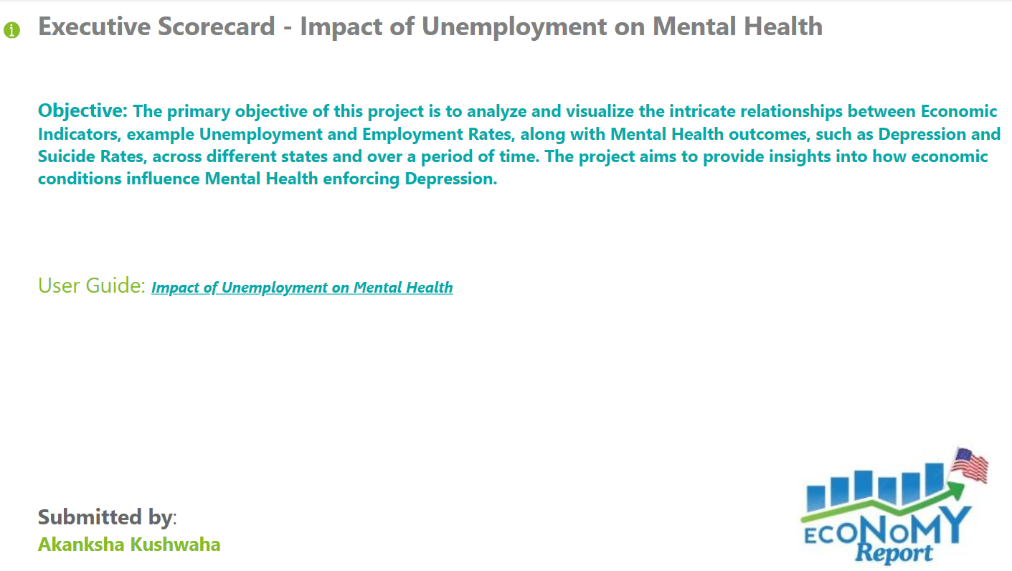
Introduction : Power BI : Tab 0: Overview Tab

Slide 6
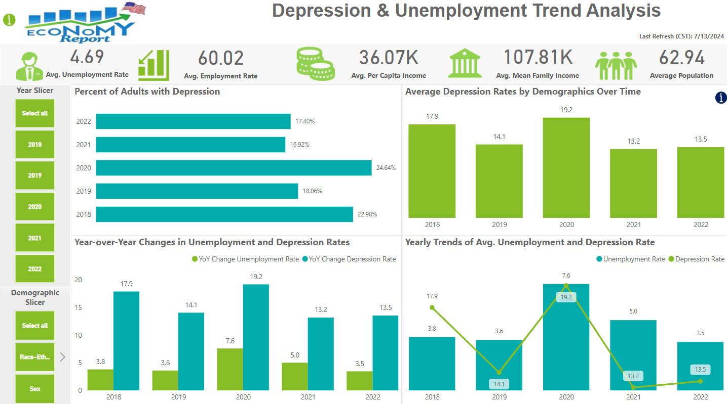
Analysis : Power BI : Tab 1: Depression & Employment Analysis

Slide 7
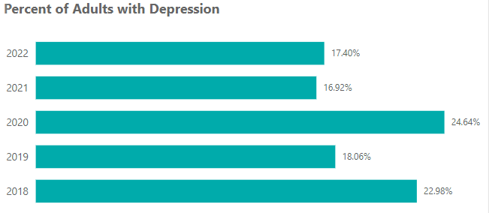
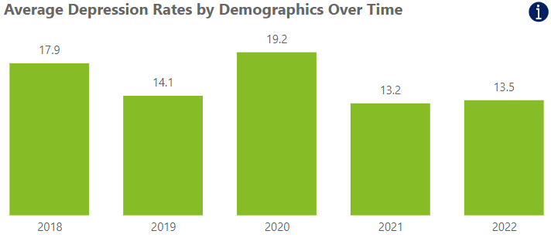
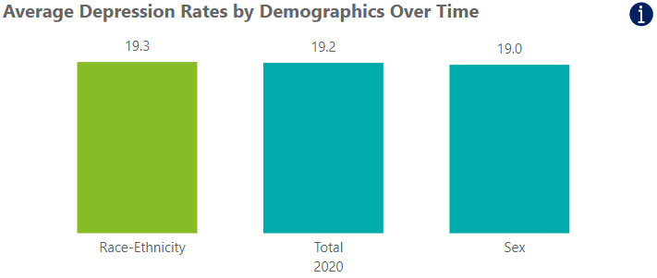
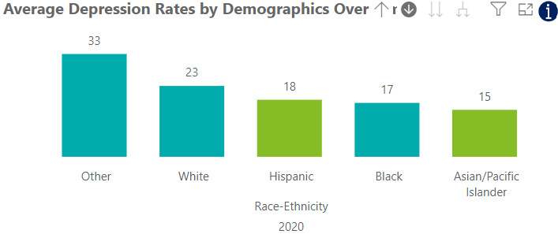
Analysis : Tab 1 : Depression and Unemployment Rate
The first chart is a Stacked Bar Chart showing annual Percentage of Adults diagnosed with Depression from 2018 to 2022.
We can see a fluctuating trend with the highest percentage observed in 2020 (24.64%) and the lowest in 2019 (18.06%).
Significant increase is seen in 2020 likely correlates with the COVID-19 pandemic, emphasizing the adverse impact of global crises on Mental Health.
In 2021, We can see that the Depression as gone down. Probably as people came out of Lock downs.
In 2022, Things remained much less the same showing slight increase.
The second Chart is Clustered Column visualization is a drill-down feature analysis of the average depression rates across different demographics over time.
Overall Trends (2018-2022):The average depression rates showed significant changes over the years, with a peak in 2020 (19.2%) and a slight increase in 2022 (13.5% from 13.2% in 2021).
Breakdown by Demographics (2020):
Race-Ethnicity: The highest average depression rates were observed among individuals classified as 'Other' (33%), followed by 'White' (23%), 'Hispanic' (18%), 'Black' (17%), and 'Asian/Pacific Islander' (15%).
Total: The overall average rate was 19.2%.
Sex: The average depression rate by sex in 2020 was 19.0%.

Slide 8
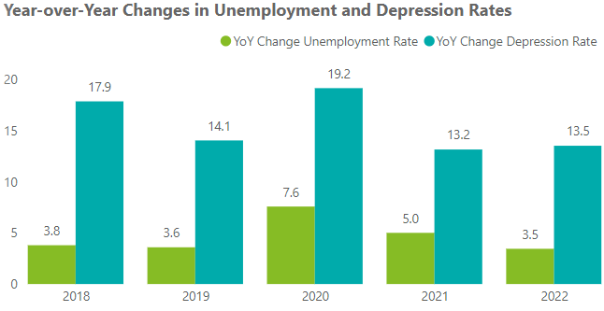
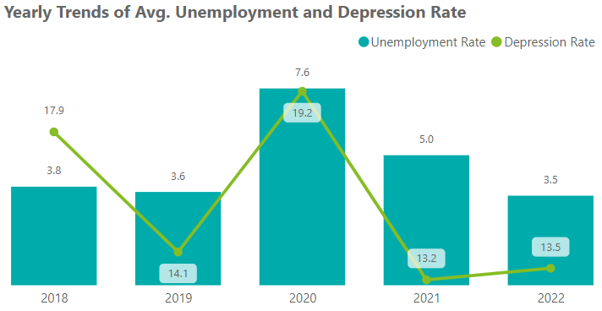
Analysis : Tab 1 : Depression and Unemployment Rate
3rd visualization is a clustered column Chart that compares the annual changes in Unemployment and Depression Rates from 2018 to 2022, highlighting how fluctuations in Unemployment may relate to changes in Depression Rates.
2018 & 2019: Depression rate increased significantly by 17.9%, while unemployment saw a slight rise of 3.8%. For 2019: Both depression and unemployment rates showed smaller increases.
2020: There was a substantial spike in both metrics, with depression rates rising by 19.2% and unemployment by 7.6%. This aligns with the onset of the COVID-19 pandemic, reflecting its widespread Economic and Mental Health impacts.
2021 and 2022: Depression rates saw a moderate increase of 13.2%, while unemployment rates rose by 5.0%. For 2022: Depression rates increased again by 13.5%, with a slight rise in unemployment rates by 3.5%.
4th visualization is a Line and Clustered Column Chart, "Yearly Trends of Avg. Unemployment and Depression Rate," presents the annual average rates of unemployment and depression from 2018 to 2022. Key trends include:
2020: Both unemployment (7.6%) and depression (19.2%) rates peaked during the pandemic.
Other Years: Fluctuating trends with noticeable decreases in 2019 and 2021.
This visual emphasizes the concurrent changes in unemployment and depression rates, suggesting a possible correlation between economic hardships and mental health challenges.

Slide 9
Research Question 1: Conclusion
Q1. What is the relationship between the temporal variations in Unemployment Rates and the prevalence of Depressive Disorders among adults over the observed period?
Explanation
Depression rates spiked in 2020 during the COVID-19, reflecting the immense economic stress and job losses experienced at that time.
Before the pandemic, Depression Rates were declining, but the sudden increase in 2020 highlights the dramatic effect of external crises on Mental Health.
In the same year, Depression Rates rose across all demographic groups, with notable increases among different racial and ethnic categories.
This widespread rise indicates that the pandemic's economic fallout affected everyone, though some communities were more severely impacted than others enforcing Mental Health.
The sharp rise in both Unemployment and Depression Rates in 2020 shows a direct link between economic downturns and mental health issues.
During stable economic periods, depression rates saw smaller changes, reinforcing the idea that stable employment is crucial for mental well-being.
This recovery pattern suggests that job market improvements can positively influence Mental Health, emphasizing the importance of economic stability for overall well-being.
Justification
These visuals tell a compelling story of how the COVID-19 pandemic and the resulting economic downturn significantly affected Mental Health in the U.S. Depression rates soared alongside rising Unemployment, showing the close relationship between economic conditions and Mental Health. As the economy recovered, Mental Health outcomes improved, showcasing the critical role of economic stability in supporting Mental Health.

Slide 10
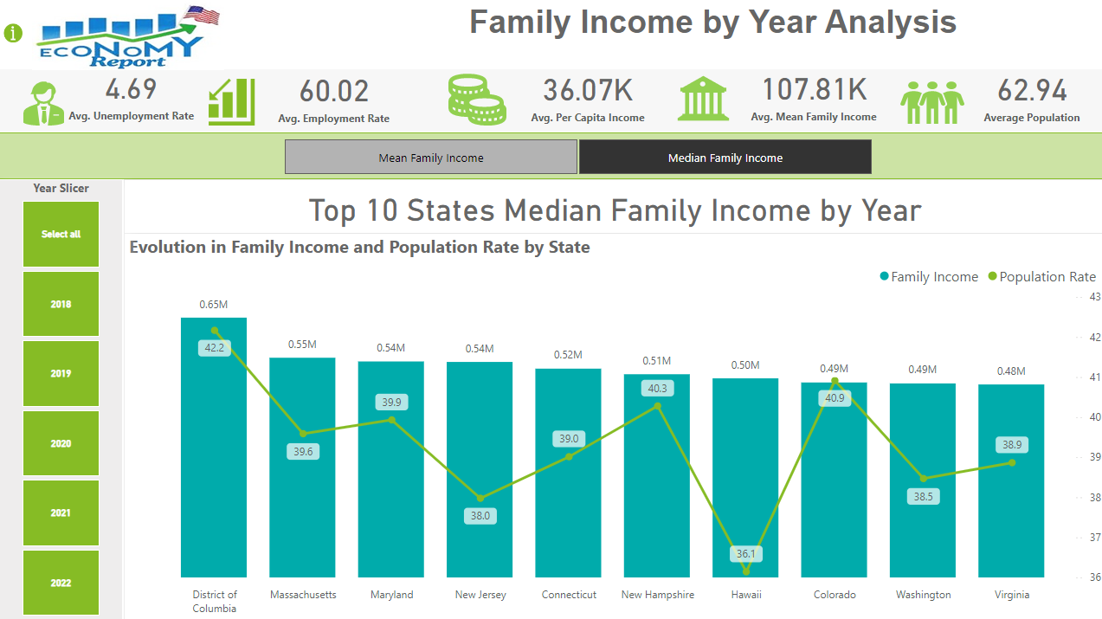
Analysis : Power BI : Tab 2 : Family Income by Year Analysis

Slide 11
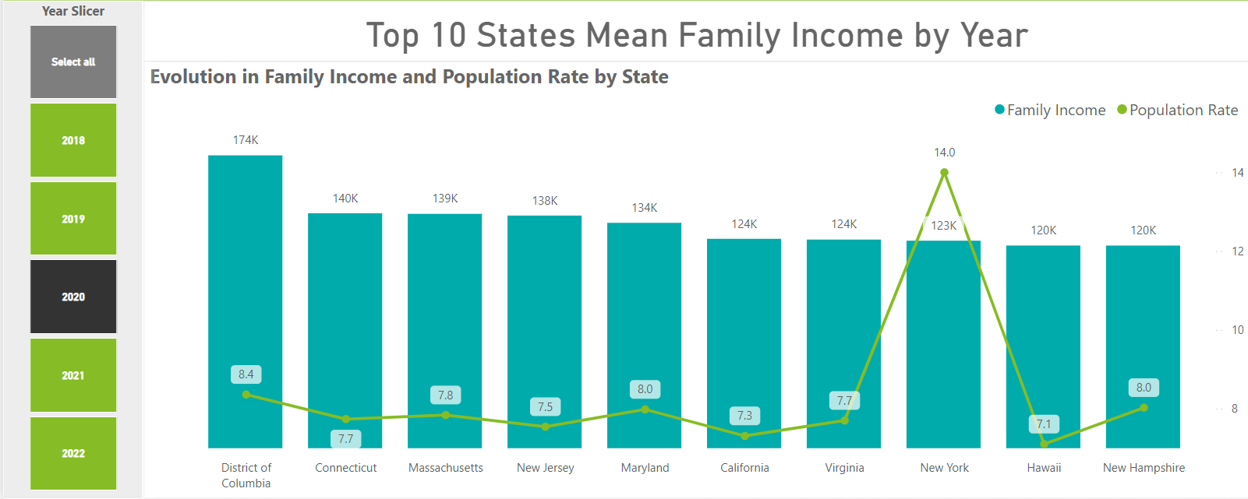
Analysis : Tab 2 : Parameterized Visual : Set to “Mean Family Income”
Top Earners by state:
This is a Line and Stacked Column Chart. It is a parameterized Visual that has 2 parameters Mean and Median Family Income.
2019: D.C. dominated with the highest average family income ($176,000!), followed by states like Massachusetts and Connecticut (around $140,000). These areas boasted strong economies but also pricier living costs. Their populations stayed steady.
2020: D.C. held onto the top spot ($174,000) even with the pandemic. Some states, like Connecticut and Massachusetts, kept their high incomes too. Interestingly, New York's population boomed (14%!), possibly due to people moving there or changing living situations during the pandemic.
2021: Good news! Average family incomes continued to climb, with D.C. reaching a whopping $192,000. Massachusetts and Connecticut stayed strong contenders (around $148,000-$151,000). This suggests a post-pandemic economic rebound. Population changes were more mixed this year, with states like Colorado and New Hampshire seeing a rise.

Slide 12
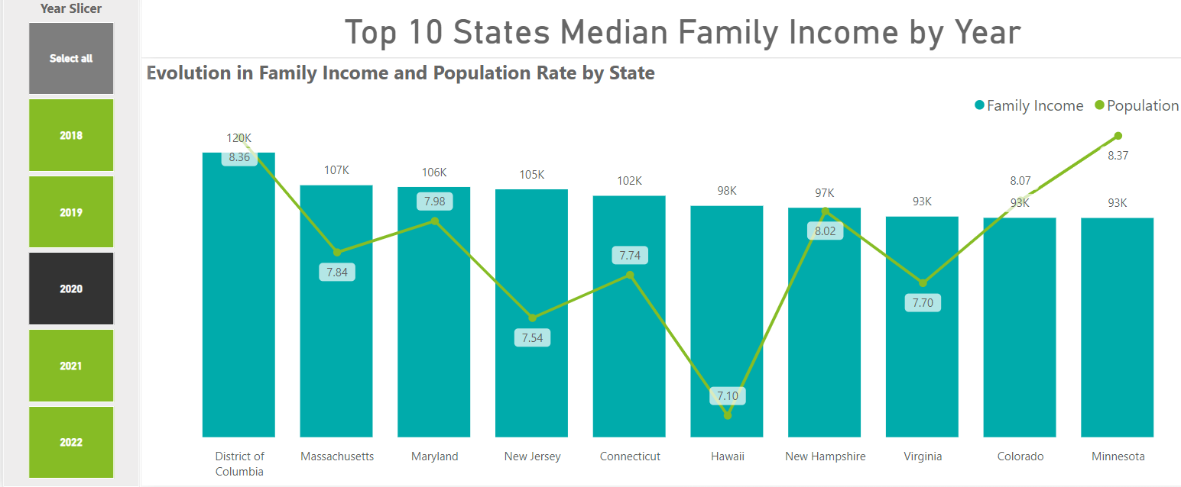
Analysis : Tab 2 : Parameterized Visual : Set to “Median Family Income”
This is a Line and Stacked Column Chart. It is a parameterized Visual that has 2 parameters Mean and Median Family Income.
2019: D.C. took the cake with a median family income of $130,000, followed by Massachusetts at $108,000. States like New Jersey and Maryland weren't far behind at around $106,000. Population growth stayed steady, with D.C. seeing an increase of 8.54%.
2020: Even with the pandemic, incomes stayed stable. D.C. remained on top at $120,000, and Massachusetts and Maryland held their own at $107,000 and $106,000 respectively. Interestingly, New Hampshire's population jumped the most (8.02%), which could be due to people moving there during the pandemic.
2021: Great news! Incomes continued to climb, with D.C. reaching $136,000. Massachusetts and Maryland also saw increases, reaching $114,000 and $111,000. This suggests things were bouncing back after the pandemic. Population changes were all over the map this year, with Colorado seeing a bigger bump (8.17%).

Slide 13
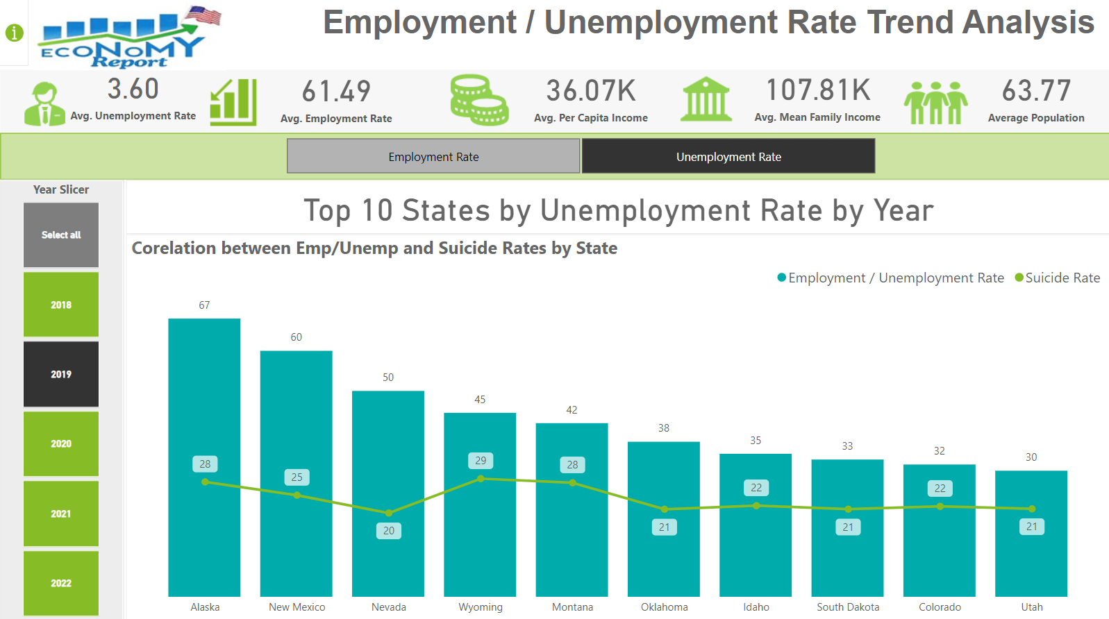
Analysis : Power BI : Tab 3: Unemp/Unemp by Year Insights

Slide 14
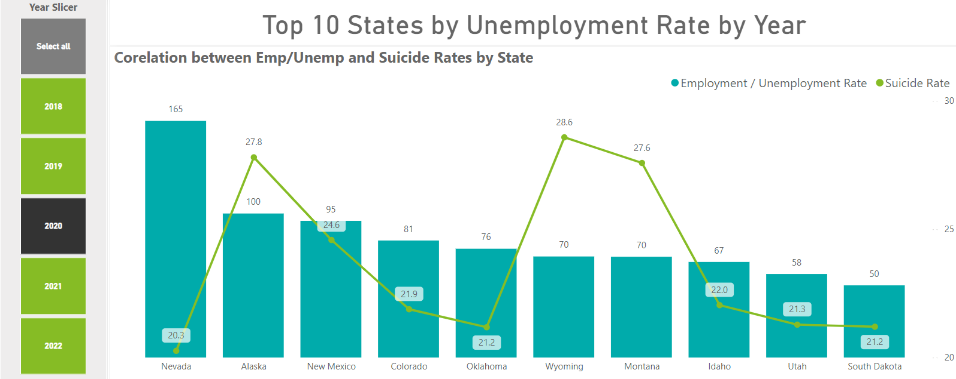
Analysis : Tab 3 : Parameterized Visual : Set to “Unemployment Rate”
This is a Line and Stacked Column Chart. It is a parameterized Visual that has 2 parameters Employment and Unemployment Rate. Job Market Blues and Mental Wellbeing
2019: In 2019, Alaska had a rough time with the highest unemployment (6.7%) - that's a lot of people out of work. It wasn't great in New Mexico (6.0%) and Nevada (5.0%) either. Sadly, suicide rates were also higher in places like Wyoming (29 deaths per 100,000 people) and Montana (28 per 100,000).
2020: The pandemic hit hard in 2020. Nevada's unemployment rate skyrocketed to a whopping (16.5% ) Alaska and New Mexico weren't far behind at 10.0% and 9.5%, respectively. Suicide rates also climbed in Wyoming (28.6 per 100,000) and Montana (27.6 per 100,000). This spike shows how job losses during the pandemic likely worsened mental health struggles, leading to more suicides
2021: There was some good news in 2021 - New Mexico and Nevada still had the highest rates at 8.5% and 8.2%. Unfortunately, suicide rates stayed high in Wyoming (28.6 per 100,000) and Montana (27.6 per 100,000).

Slide 15
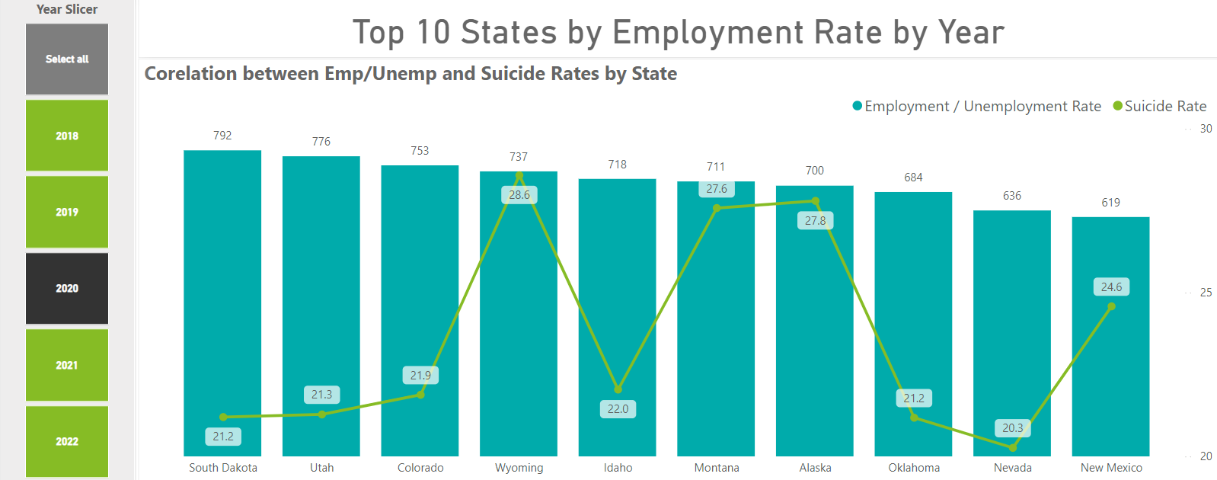
Analysis : Tab 3 : Parameterized Visual : Set to “Employment Rate”
This is a Line and Stacked Column Chart. It is a parameterized Visual that has 2 parameters Employment and Unemployment Rate.
2019: States like South Dakota, Colorado, and Utah were buzzing with employment. But here's the twist: Wyoming had a high number of suicides, even though many people had jobs.
2020: In 2020, Some states, like South Dakota, Utah, and Colorado, managed to hold onto decent employment rates. But sadly, suicide rates stayed high in places like Wyoming and Alaska. This suggests that the stress and uncertainty of the pandemic might have made existing mental health struggles even worse.
2021: As things started to bounce back in 2021, employment rates began to stabilize. South Dakota, Utah, and Colorado were still leading the pack on jobs. However, suicide rates in Wyoming and Alaska remained high.

Slide 16
Research Question 2: Conclusion
Q2. How do unemployment rates correlate with suicide rates across the top 10 states with the highest unemployment, and what are the trends across the top 10 states with the highest in Mean and Median family income with respect to Population over the years?
Explanation
Mean and Median Family Income Trends
For Mean : Over the years the District of Columbia and Massachusetts from 2019 to 2021, these states showed a consistent rise in mean family incomes, indicating economic resilience and growth. Population rates in these states remained relatively stable, suggesting a balance between economic prosperity and population growth.
For Median : Similarly, states with the highest median family incomes, including the District of Columbia and Maryland, exhibited robust economic health. Despite the pandemic, these states managed to maintain or slightly increase their median family incomes. Population trends in these states also showed stability, reflecting the overall economic strength and attractiveness of these regions.
Unemployment Rates and Suicide Rates Correlation
2020, Nevada experienced a significant spike in Unemployment due to the COVID-19 pandemic, which coincided with a rise in suicide rates, reflecting the severe Mental Health impact of economic distress. The concurrent rise in suicide rates during periods of high unemployment underscores the direct correlation between economic hardship and mental health struggles.
Justification
As seen High Unemployment Rates are strongly linked to higher Suicide Rates. Data from the top 10 states with the highest Unemployment Rates show that economic distress leads to increased Mental Health challenges, evident in the rise of Suicide Rates during periods of high Unemployment. States with the highest mean and median family incomes demonstrate economic resilience and growth, maintaining or increasing their incomes even during the pandemic, indicating strong economic foundations. In conclusion, the analysis highlights the significant impact of economic conditions on Mental Health, with high Unemployment Rates correlating with increased Suicide Rates.

Slide 17
Extra Research Questions:
Q3. How do economic factors, healthcare access, and demographic characteristics influence mental health outcomes, specifically the incidence of suicide, across different states by population factor? (I have answered this Question in Tab 4)
Q4. What is the impact of long-term unemployment on chronic diseases across different states?
Q5. How does the duration of unemployment correlate with different mental health outcomes (e.g., anxiety, depression, substance abuse)?
Q6. What is the impact of access to mental health services on the relationship between unemployment and suicide rates?
Q7. What is the role of social media usage in influencing mental health outcomes during periods of economic stress?

Slide 18
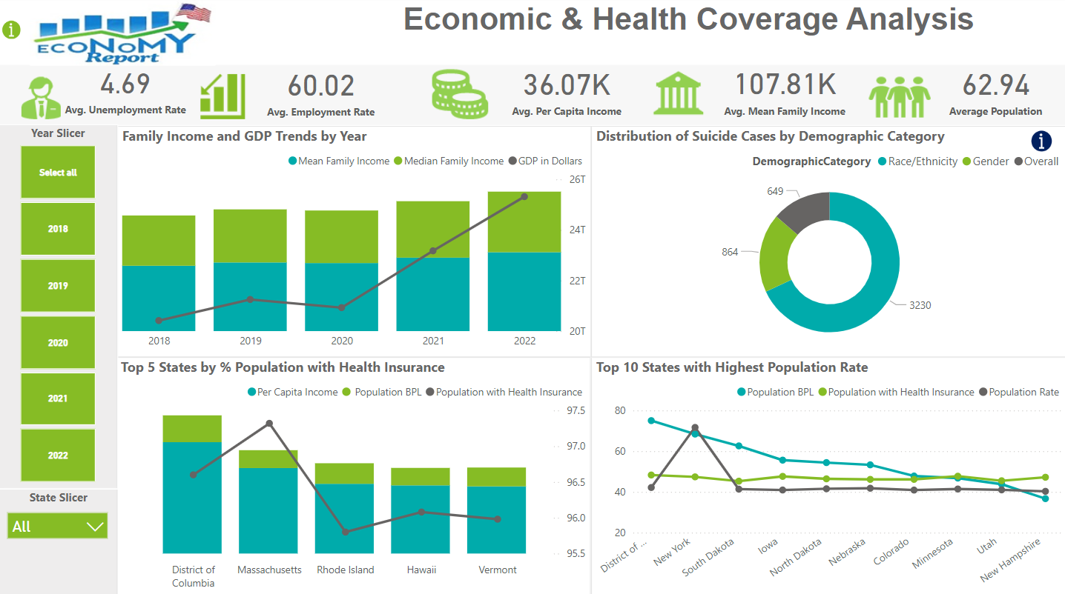
Analysis : Power BI : Tab 4 : Economic & Health Coverage Analysis

Slide 19
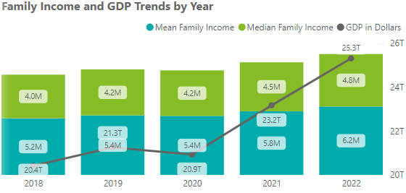
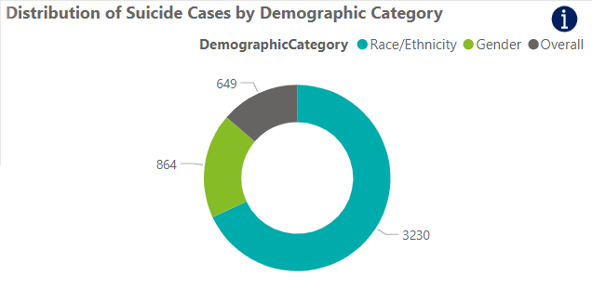
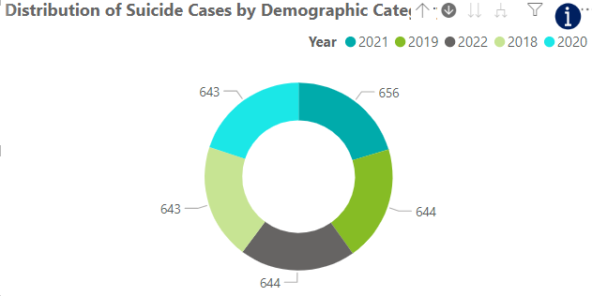
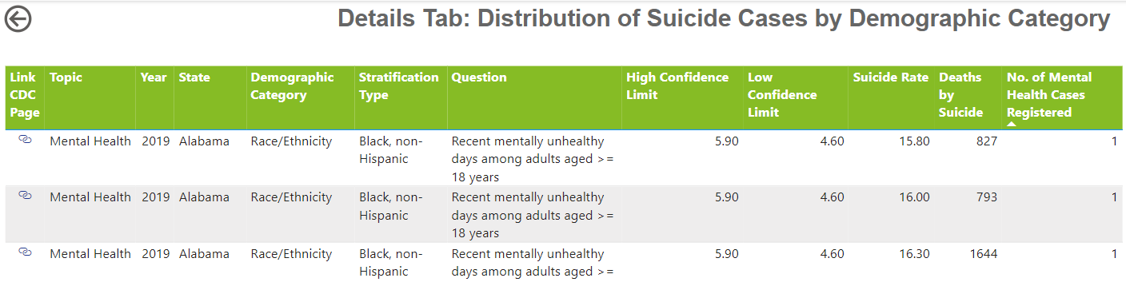
Analysis : Tab 4 : Economic & Health Coverage Analysis
1st visualization is a Line and Stacked column Chart that compares the Income and GDP trend by year.
In 2018, the mean family income was $4.0M, and the median family income was slightly higher at $5.2M. The GDP for the year was $20.4T.
In 2019, the mean family income increased to $4.2M, while the median family income remained stable at $5.2M. The GDP rose to $21.3T, indicating economic growth.
The year 2020 saw the mean family income holding steady at $4.2M, with the median family income increasing to $5.4M. The GDP slightly decreased to $20.97T, likely due to the economic impacts of the COVID-19 pandemic.
In 2021, the mean family income rose to $4.5M, and the median family income increased to $5.8M. The GDP showed a significant recovery, reaching $23.2T, indicating strong post-pandemic economic recovery.
The year 2022 saw the mean family income further increasing to $4.8M, and the median family income reaching $6.2M. The GDP peaked at $25.3T, reflecting sustained economic growth and expansion.
4th visualization is Pie Chart, comparing top 5 states from 2018 to 2022.
The visuals represent the distribution of suicide cases by demographic category, with drill-down and drill-through details.
The first pie chart shows that most suicide cases are categorized by race/ethnicity (3,230 cases), followed by gender (864 cases), and overall (649 cases).
The second pie chart drills down into the yearly distribution, showing relatively even cases from 2018 to 2022, ranging from 643 to 656 cases per year. The detailed table for 2021 in Alabama shows data by race/ethnicity, with suicide rates between 4.90 and 5.00, deaths ranging from 793 to 1,644, and each record indicating 1 mental health case registered.
These visuals provide a comprehensive overview of the distribution and detailed factors associated with suicide cases.

Slide 20
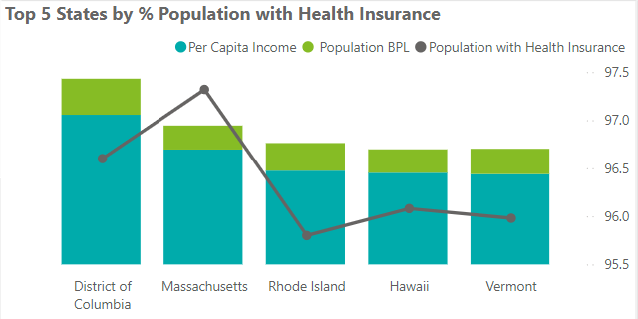
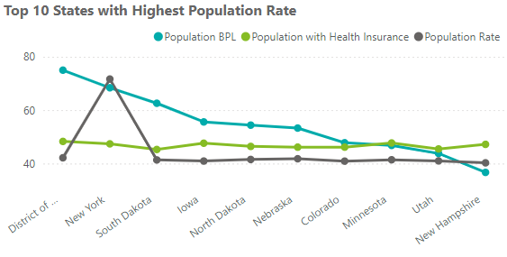
Analysis : Tab 4 : Economic & Health Coverage Analysis
3rd visualization is a Line Chart. This visual compares the top 10 states with the highest population rates, focusing on Population Below Poverty Line (BPL), Population with Health Insurance, and overall Population Rate.
District of Columbia: 75% BPL, 48% insured, 42% population rate
New York: 68% BPL, 42% insured, 45% population rate
South Dakota: 12% BPL, 45% insured, 41% population rate
Iowa: 63% BPL, 48% insured, 41% population rate
North Dakota: 54% BPL, 48% insured, 42% population rate
Nebraska: 53% BPL, 42% insured, 41% population rate
Colorado: 56% BPL, 41% insured, 41% population rate
Minnesota: 54% BPL, 41% insured, 41% population rate
Utah: 47% BPL, 40% insured, 41% population rate
New Hampshire: 44% BPL, 44% insured, 41% population rate
Poverty vs. Health Insurance: DC and New York have higher poverty but also higher overall population rates, potentially skewing data perceptions.
2nd visualization is Line and Stacked column Chart, comparing top 5 states from 2018 to 2022.
The visual compares the top 5 states by health insurance coverage, highlighting per capita income and population below the poverty line (BPL).
District of Columbia: $62,000 income, 15% BPL, 96.60% insured.
Massachusetts: $48,000 income, 10% BPL, 97.32% insured.
Rhode Island: $39,000 income, 12% BPL, 95.80% insured.
Hawaii: $38,000 income, 10% BPL, 96.08% insured.
Vermont: $38,000 income, 11% BPL, 95.98% insured.
Despite income and poverty variations, these states maintain high health insurance coverage, with Massachusetts leading at 97.32%. This indicates effective healthcare access across different economic conditions.

Slide 21
Research Question 3: Conclusion
Q3. How do economic factors, healthcare access, and demographic characteristics influence mental health outcomes, specifically the incidence of suicide, across different states by population factor?
Explanation & Justification
The provided visuals collectively address this question by presenting data on economic factors, healthcare access, demographic characteristics, and population metrics in relation to mental health outcomes, particularly suicide rates.
These visuals show rising GDP and family incomes from 2018 to 2022, indicating economic growth and improved financial stability towards 2022, which can positively impact mental health.
Top 5 States with Health Insurance visual compares health insurance coverage, per capita income, and poverty levels across states. States with higher health insurance coverage often have better mental health outcomes due to improved access to healthcare services.
The pie chart highlights the distribution of suicide cases by race/ethnicity and gender, showing that demographic characteristics play a significant role in understanding suicide rates.
Top 10 States with Highest Population Rate visual compares poverty, Health Insurance coverage, and Population Rates. It shows how higher population states like New York and DC have varied poverty and insurance data, affecting mental health outcomes.
Note : Population visual provides additional context for analyzing income, poverty, and health insurance coverage. It shows that higher population states like the DC and New York have more people below the poverty line and without health insurance. This perspective highlights how population size influences the perception of poverty and insurance coverage, emphasizing the importance of considering population metrics in socioeconomic analysis. The insights complement Visual 2, illustrating the complexity and multifaceted nature of economic well-being across different states.

Slide 22
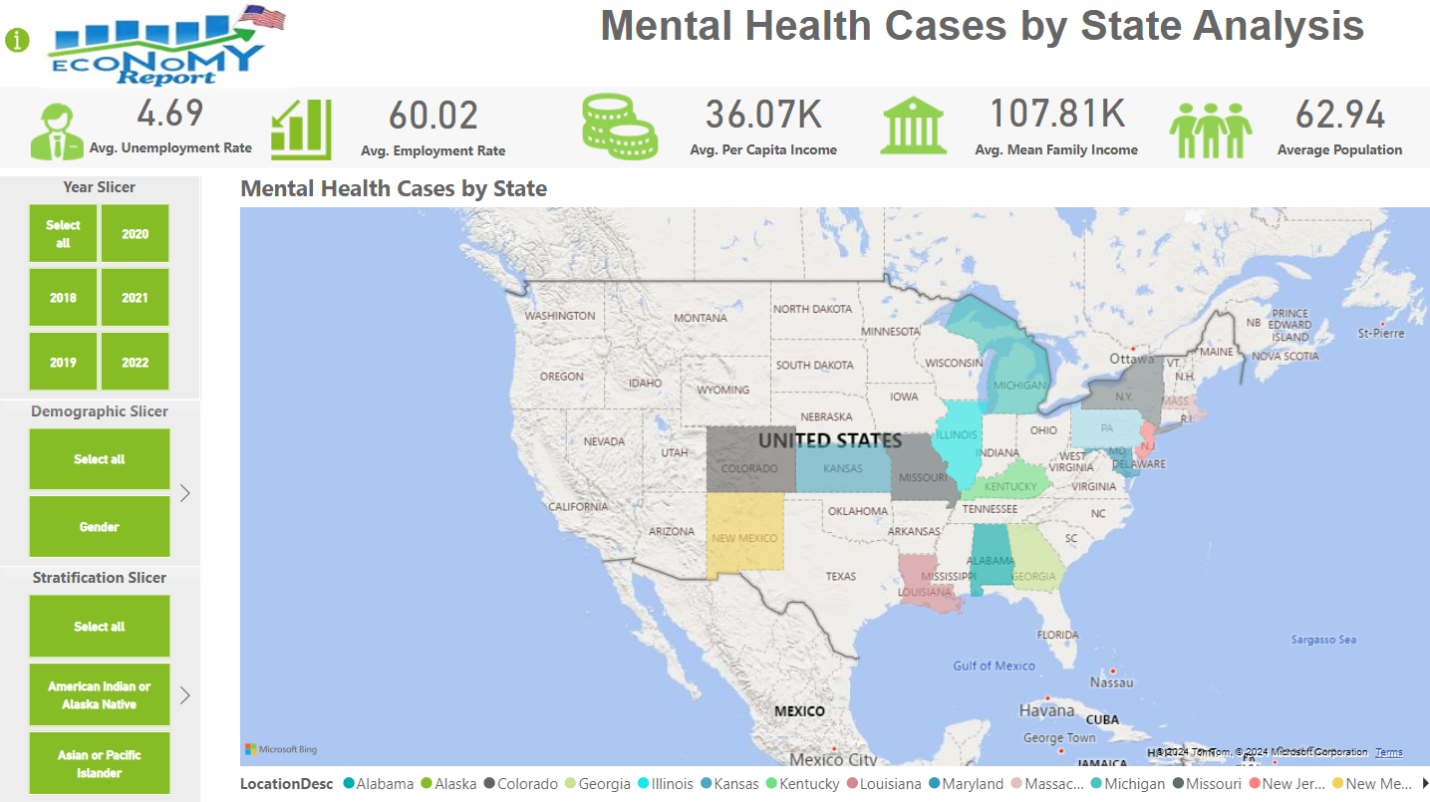
Analysis : Power BI : Tab 5 : Mental Health Cases by State Analysis
Justification: This is a Map Visual. It provides a comprehensive overview of mental health case distribution across the Country by State and allows for detailed analysis based on year, demographics, and stratification categories.

Slide 23
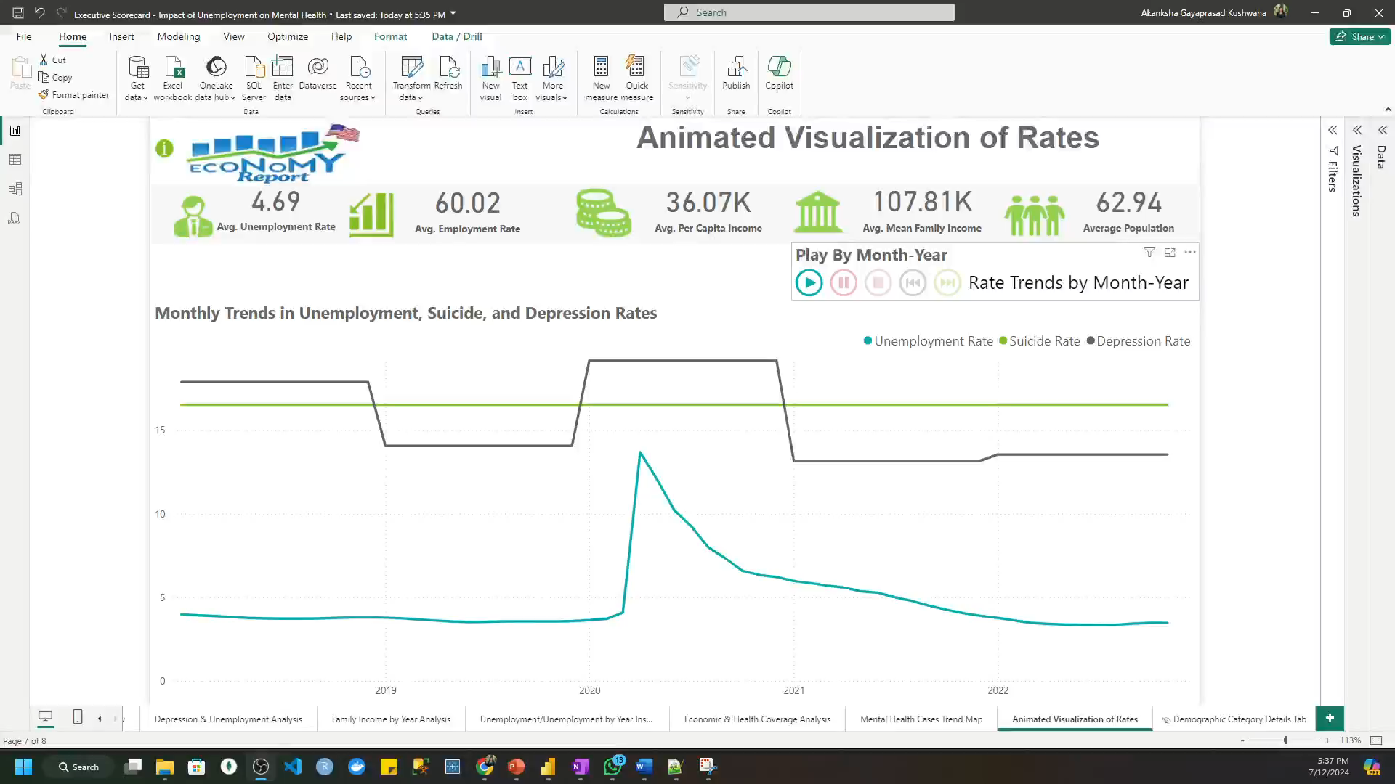
Analysis : Power BI : Tab 6 : Mental Health Cases by State Analysis
Justification: The visual highlights the significant impact of economic factors (Unemployment) on Mental Health outcomes (depression and suicide rates). The spike in the unemployment rate in 2020 corresponds with the onset of the COVID-19 pandemic, showing a sharp increase, which then gradually declines as the economy recovers. The suicide rate shows some fluctuation but remains relatively stable, while the depression rate is persistently high, indicating ongoing mental health challenges irrespective of economic conditions

Slide 24
We have Successfully Analyzed the Research Questions.
Consulting.inc
Power BI

Slide 25
Thank You!!!
Consulting.inc
Power BI
Submitted by:
Akanksha Kushwaha

